Slide 1




AIR Monitoring Application
Instructor: Mr. Thai Huy Tan
Group 02
Students:
Dang Quoc Hung
Bui Si Khoa
Do Huynh My Tam
20520194
20521461
20520746

Slide 2


Table of contents
1. Introduce the topic
5. Video Demo made
3.Project
2.Implementation tools
4. Extra features

Slide 3

1. Introduce the topic

Slide 4












1.1 Reasons for choosing the topic
Go out for the Air
Nam comes in UIT and wanted to go out for the air.
What is the atmosphere like ?
Should she wear a mask ?
What was the atmosphere like the day before ?

Slide 5
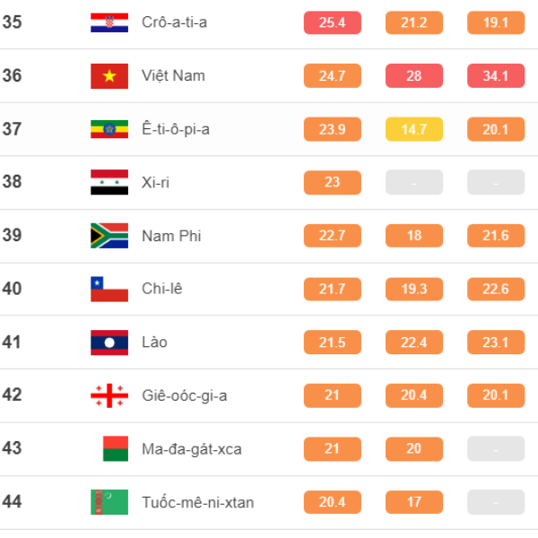
1.1 Reasons for choosing the topic
With increasing awareness of the impact of air pollution on health, this application aims to empower users to understand and improve their indoor environments.
Nguồn: Iqair.com

Slide 6

1.2 Goal
The goal of this final project
To create a application focused on monitoring indoor air quality in real-time.
The application will be responsible for collecting data from multiple cloud devices that measure various air quality parameters

Slide 7
2.Implementation tools

Slide 8



2.1 Implementation tools
Git/github
Synchronize the team's source code to a server.
Support operations to check source code during work (diff, check modifications, show history, merge source, ...)
Android studio
Official IDE for Android application development
Provides interfaces that help users create applications and handle complex file tools

Slide 9
2.2 Library
com.jjoe64:graphview :Draw
intuitive graphs and charts in Android apps
com.google.android.gms:play-services-maps :can display the map, mark locations, add markers, and customize the map appearance
com.squareup.retrofit2 : Support call API
com.google.code.gson : convert between Java objects and JSON format
com.squareup.okhttp3: Provides flexible mechanisms for handling HTTP requests and responses
Notes:
com.jjoe64:graphview : Vẽ đồ thị và biểu đồ trực quan trong ứng dụng Android
com.google.android.gms:play-services-maps :có thể hiển thị bản đồ, đánh dấu vị trí, thêm điểm đánh dấu và tùy chỉnh giao diện bản đồ
com.squareup.retrofit2 : API cuộc gọi hỗ trợ
com.google.code.gson : chuyển đổi giữa các đối tượng Java và định dạng JSON
com.squareup.okhttp3: Cung cấp cơ chế linh hoạt để xử lý các yêu cầu và phản hồi HTTP

Slide 10
3.Project

Slide 11

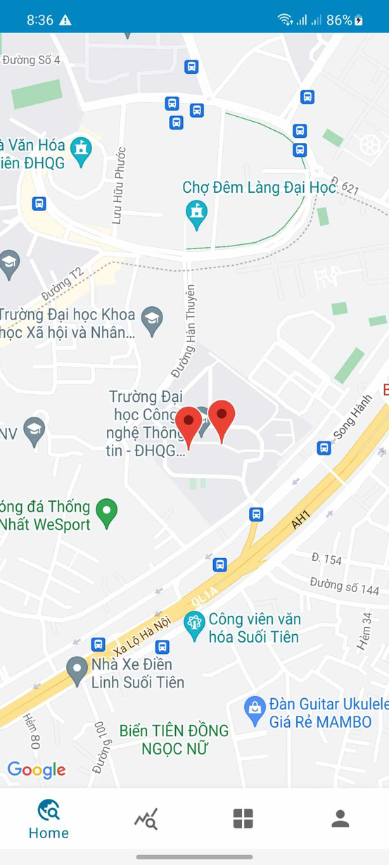
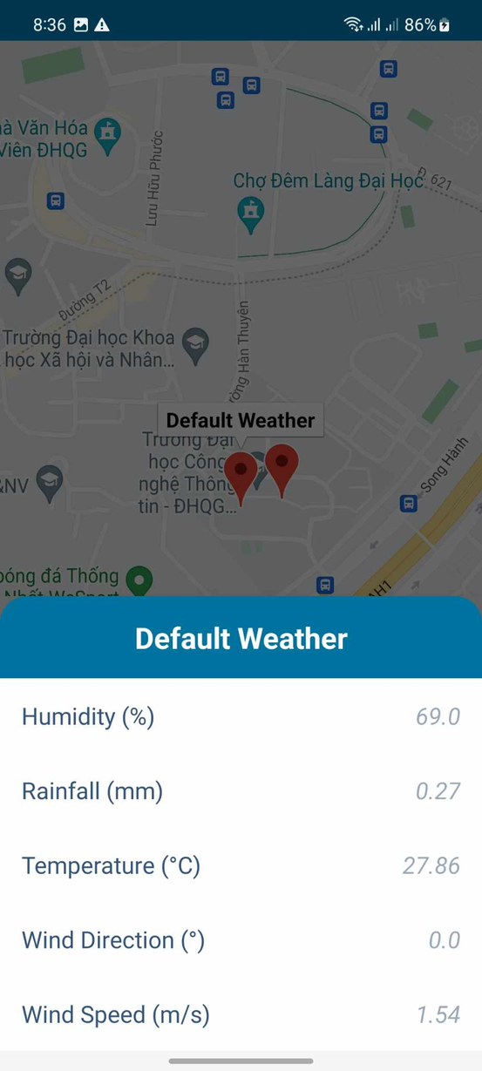
3. Home Screen
View different devices on map, with zoom in, zoom out supported.
4

Slide 12
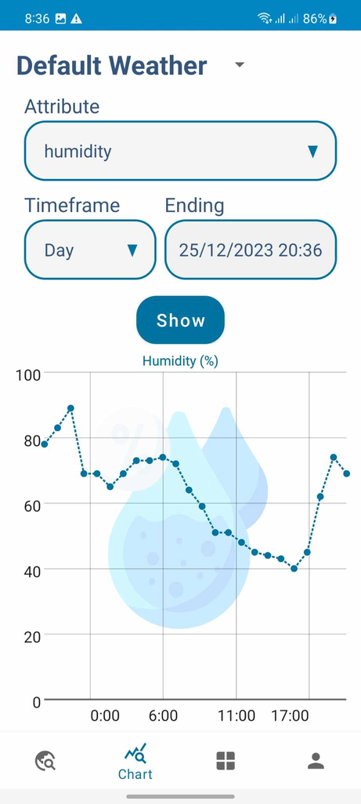
3. Chart
Here, users can view air indicators at custom intervals and timelines for analyzing past data trends.
5

Slide 13
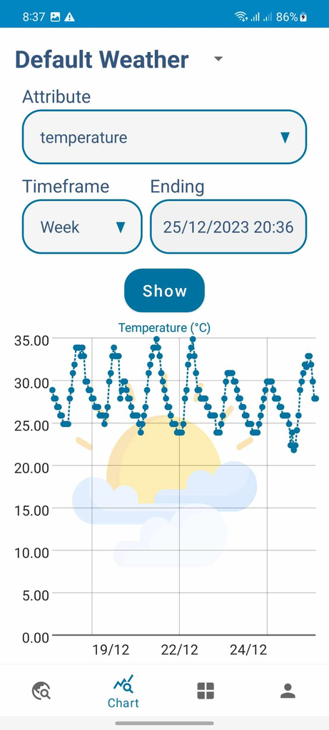
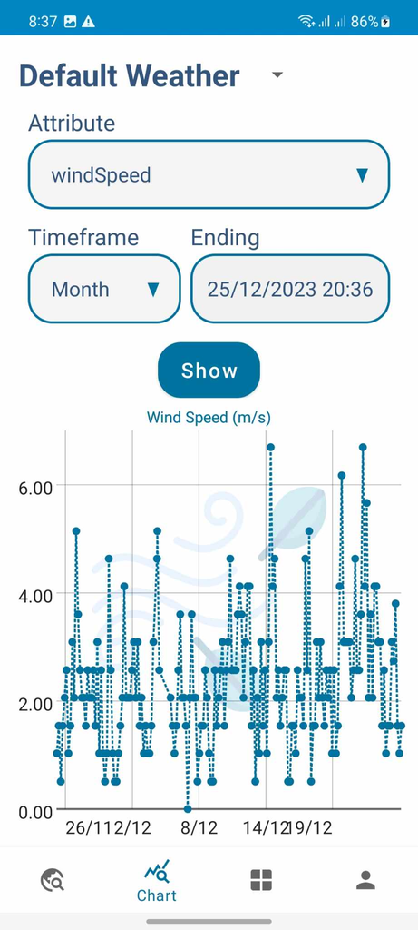
3. Chart
5

Slide 14
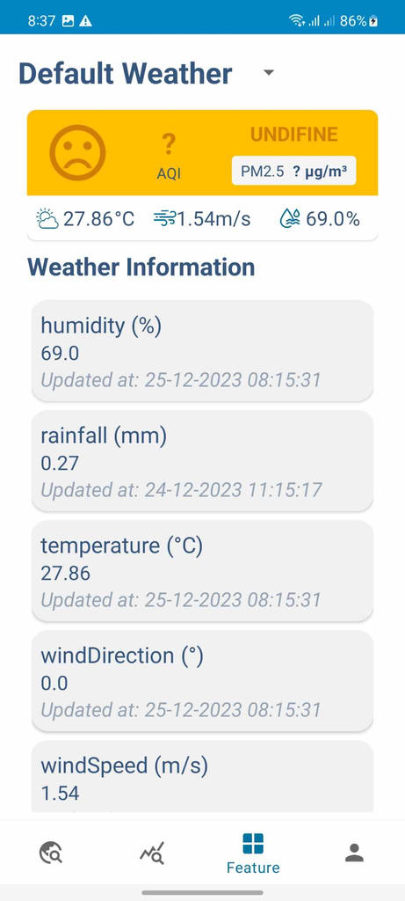
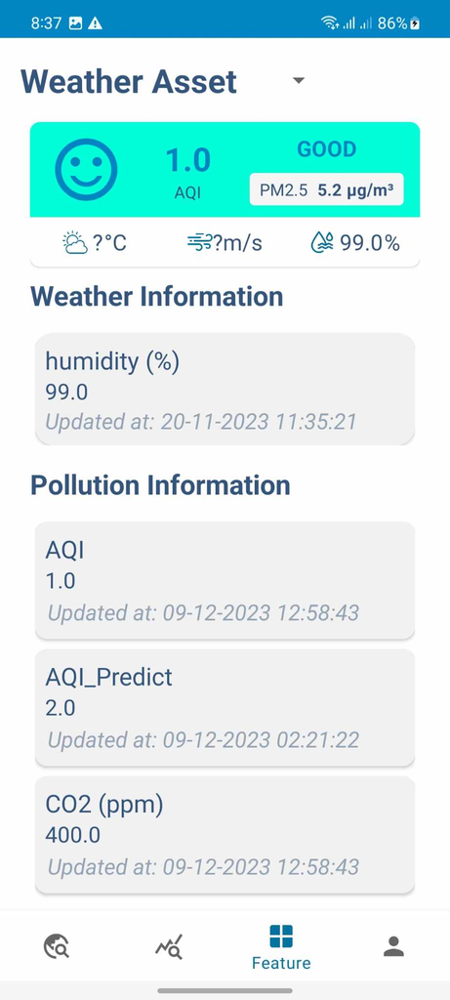
3. Features
Develop Feature
6

Slide 15
4. Extra features

Slide 16
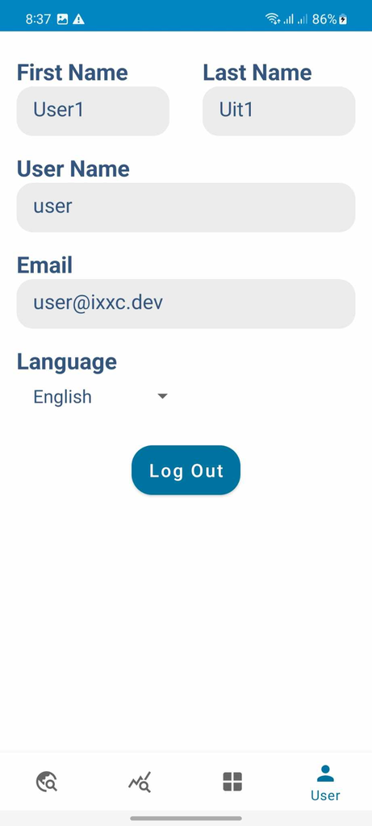
4. Extra features
Language change feature: users can choose the appropriate language
Log out: User can log out to sign in to another account
7
Notes:
Language change feature in the right corner of the screen, users can choose the appropriate language

Slide 17
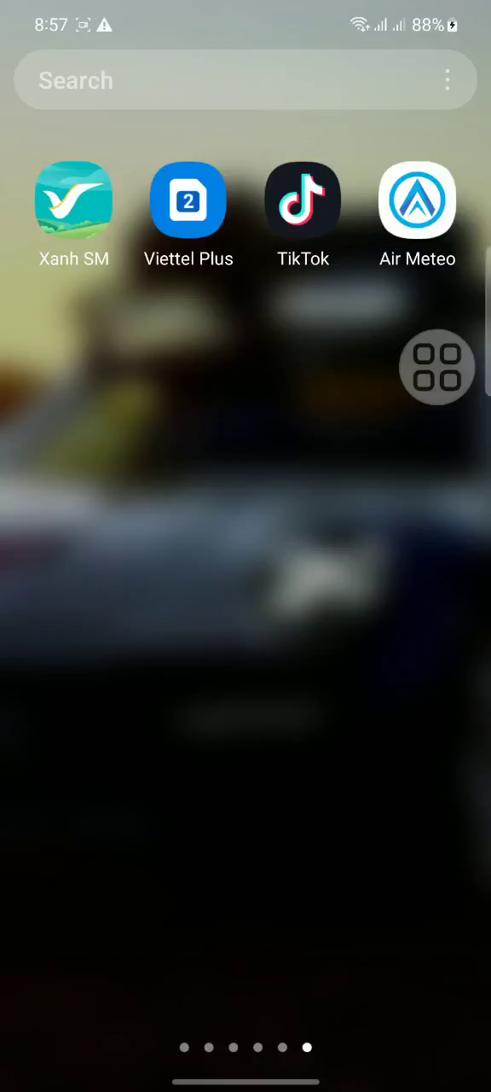
5.Video Demo

Slide 18





